Slide 1
System and Network Administration
Core Services:
email

Slide 2
Electronic Mail
E-mail is the ONLY universal mission-critical application
Each person/group will have various mission-critical applications
But the only application that everyone depends on is e-mail
Keeping e-mail flowing is a required task for most system administrators.
For the administrator this means:
Choosing and configuring a mail transport agent
Thinking through
the site’s e-mail model,
user agents, and
hardware required to provide this critical service.

Slide 3
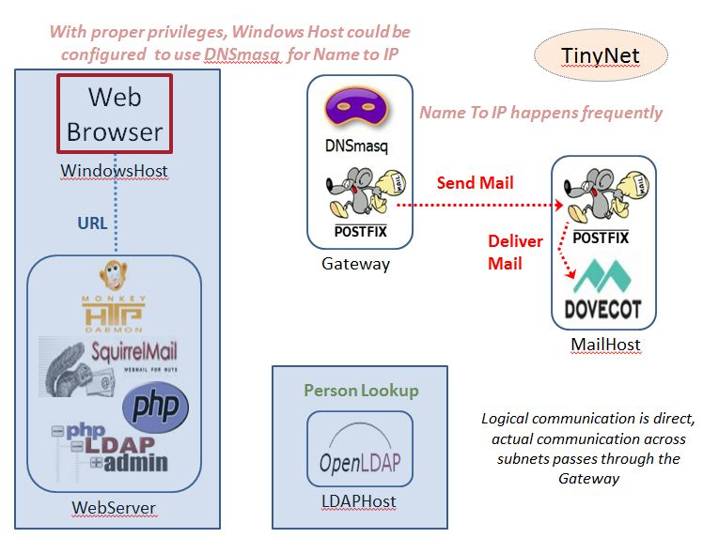

Slide 4
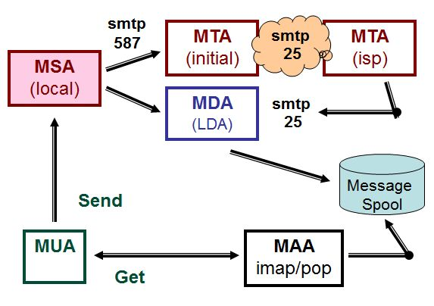
Mail - Abstract Architecture
In our setup, SquirrelMail is the MUA; Postfix on the Gateway is a MTA; Postfix on the Mailserver is the MSA when it receives mail from SquirrelMail and the MDA when it receives mail from Postfix on the Gateway; Dovecot on the MailServer is the LDA (called by Postfix for putting messages in mailboxes) and the MAA (imap server).
MUA – Mail User agent
MSA – Message Submission agent
MTA – Mail Transport agent
MDA – Mail Delivery agent
MAA – Mail Access agent

Slide 5









(dns 53)
(MX record)
(smtp 25)
relay host
(smtp 587)
gateway
address
rewriting
(smtp 25)
mailhost
local delivery
(imap 143)
vmail
accounts
(ldap 389)

Slide 6
Message, Envelope, Headers
The MSA places the message in an “envelope” for delivery.
There is a header on the message and another header on the envelope.
These contain addresses and other information about the message.
Message headers can be (and are) easily forged by user.
Users typically do not see the envelope.
Envelope headers are (normally) created, changed, and deleted by MTAs
Every message is assigned a unique ID by each MTA that handles it.
This allows tracing the message from end to end (if log files are available).

Slide 7
EMail Overview – SMTP
sending end introduces itself
sending end tells who mail is from
sending end tells who mail is for
If the destination user is valid / relaying is permitted, open a spool, and continue the process. More on this in a minute…
Sending end transfers data
Sending end closes connection
SMTP protocol
HELO – introduce yourself
AUTH – authenticate this user
MAIL FROM – who
RCPT TO – (message to)
VRFY – see if this user exists.
EXPN – expand this address and tell me who it is
DATA – body of the message
DSN – delivery status notice
RSET – reset the connection
NOOP – do nothing
VERB – verbose mode
QUIT – close the connection

Slide 8




Slide 9
Web-based Mail
A web-based mail client is a suite of CGI programs that act as a mail client using a web browser as the user interface.
Requires obtaining and installing the needed CGI programs and supporting programs and adding them to the web server configuration
For example, SquirrelMail requires a webserver, PHP, and an IMAP server, as well as the SquirrelMail software.
Web-based mail can be used from any client platform that has a web browser.

Slide 10
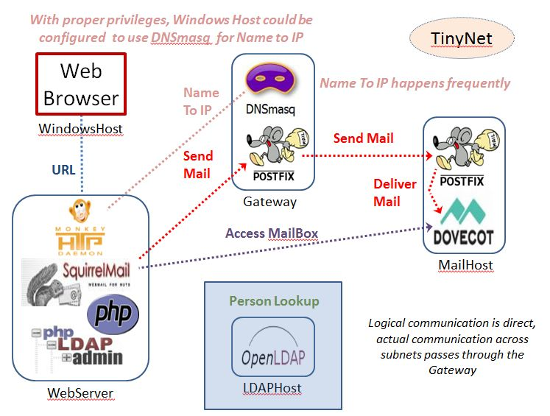
Configure Webmail

Slide 11
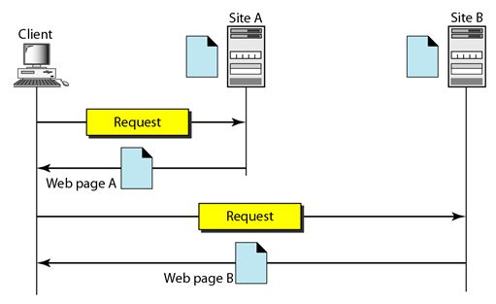
Web Services
Uses HTML for message format and HTTP for message transport
HTTP: TCP port 80
HTTPS: TCP port 443 (SSL)
Each component of the page is retrieved separately and combined for display in the browser

Slide 12
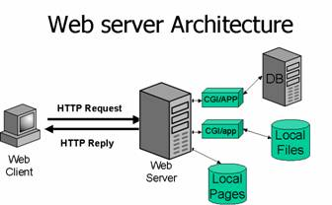
CGI/app
Can be written in any language,
PHP, Python, C# (ASP.NET), and JavaScript are all popular
Webserver itself only serves HTML pages
(DocumentRoot)
monkey is the TinyNet default server
apache is the most popular
lighttpd is preferred by many
Internet Information Server (IIS) is Microsoft
Virtual Hosts :
Multiple Web sites managed by a single server

Slide 13
(dns 53)
(MX record)
(smtp 25)
relay host
(smtp 587)
gateway
address
rewriting
(smtp 25)
mailhost
local delivery
(imap 143)
vmail
accounts
(ldap 389)

Slide 15
RFC 2476 + RFC 4409:
Message Submission
smtp
smtp
smtp
MSA
(local)
587
MTA
(initial)
25
Relay MTAs
25
MTA
(destination)
Defines the difference between mail transfer and message submission:
Submission is intended to be from client to initial server.
SMTP protocol, port 587
Transfer is intended to be server to server (relay)
SMTP protocol, port 25
Allows administrators to run two distinct services configured optimally for each purpose rather than a single MTA service that has to make allowances for different types of use

Slide 16
Email – Submission
smtp
smtp
MSA port 587 should be limited to internal hosts
MSA
(local)
587
MTA
(initial)
25
MSA converts mail to “canonical form”, for example by adding @domain to mail submitted with a simple user name
MSA does other address rewriting, for example changing user@host.domain to Given.Family@domain (masquerading)
MSA authenticates clients: able to require encryption and SMTP authentication for port 587 sessions

Slide 17
DNS Necessities
Canonical name for hosts
lookup record - Name to IP
MX records
so MTAs can find the address to connect to
example.com IN MX 10 mailhost.example.com.
MSAs don’t really need MX, initial MTA can be hard coded
Mailserver reverse lookup record - IP to Name
for validation purposes

Slide 18
Relaying
smtp
smtp
MTA
(initial)
25
Relay MTAs
25
MTA
(destination)
MX (Mail eXchanger) record
priority allows multiple possibilities for getting mail delivered
MTA configuration
Accept mail for certain destinations, then pass it along
open relay = bad netizen
likely to be used for spam

Slide 19
Many different configurations are possible
Local delivery for users with an account on the system
Local delivery for virtual users (no account on the system)
Virtual hosting for domains, mail delivered to local user (virtual or actual)
Mail sent to a gateway then forwarded on to individual mailservers – MUA talks to configured gateway MSA
Local mail sent to local mailserver, external mail sent to gateway – MUA talks to localhost
Weird and wonderful combinations will work!
Lots of decisions to make, Lots of documentation to read

Slide 20
How complicated is it?
postfix
sets 530+ defaults
sendmail:
55+ features
180+ defines, many with several distinct options
these are used to configure
18 classes
16 rulesets
15 macros
9 m4 diversions (subroutines)
dovecot:
About 150 defaults plus (2*7) database options

Slide 22
Troubleshooting
Stop! Don’t Rush
Make one change at a time – test
Start at one end, move up or down the network layers
Communicate regularly
Work as a team
Document before and changes
Requires skills of
Mechanic
Sociologist
Researcher

Slide 23
Problems?? Check the “4 peas”
Paths
Permissions
Ports
Parsing (typos)

Slide 24
Correcting Faults
Gather evidence
Make an informed guess
(just fix it, see if it works --
BUT be able to go back to the previous and original !!)
Try to reproduce the error

Slide 25
Troubleshooting
It is best to test a network service locally first.
Use netstat –an to check that the port number associated with the service is active and in the LISTENING state.
Check which IP address the port is bound to -- some services may only be bound to use one or another interface .
Check is if the service responds at all by trying the service using a local client, which does not involve host-to-host connectivity.
The local service is naturally found at the localhost address (127.0.0.1, or just identify localhost as the hostname).
Examine the log using tail –f
shows all messages received and sent by the server

Slide 26
Troubleshooting Scenario: Webserver
If the web server will not start for no apparent reason:
1. make sure that the pid file doesn't already exist
ls -l /var/run/httpd.pid
-rw------- 1 root sys Feb 14 19:23 /var/run/httpd.pid
2. If the file exists while the server is stopped then delete it
rm /var/run/httpd.pid
3. restart the service ... for example
/etc/rc.d/apache restart
4. Use netstat –an to check that port 80 is active and in the LISTENING state.

Slide 27
Troubleshooting Scenario (cont.)
5. try the local service – you don’t even need a browser
telnet localhost 80
GET /
6. Examine the log using tail –f
shows all messages received and sent by the server
Still having problems?
(a) Increase the Loglevel verbosity, for example from...
LogLevel warn to LogLevel debug
(b) restart the service - examine the log using tail –f

Slide 28
Still having problems?
(c) Start the process from the shell to capture console logging
Look at the rc.d startup script to find the actual command that is being executed, and run it yourself from the command line
/usr/sbin/apachectl start
dynamic linker : /usr/sbin/httpd : could not open libmhash.so.2
/usr/sbin/apachectl: 29125 Killed
/usr/sbin/apachectl start: httpd could not be started
we find that the apache server couldn't start because it couldn't locate a linked library

Slide 29
Missing Libraries
If you are missing a library, use the command
find / -name "libname*"
using the library name from the error message.
If it exists, fix it with a symlink to the path specified in the error message, or put the symlink in /usr/lib or /usr/local/lib if it is not already there.
Lots of times the library is called libxyz.so.2.0.0 when the program wants libxyz.so so this is pretty easy

Slide 30
Troubleshooting Scenario (cont.)
(d) Doublecheck this using ldd like so...
cd /usr/sbin
ldd ./httpd
./httpd needs:
libldap.so.2 => /var/opt/lib/libldap.so.2
/usr/lib/libcurl.so.2
/usr/lib/libgnuintl.so.4
dynamic linker : ./httpd : could not open libmhash.so.2
in this scenario we know that libmhash.so.2 resides in /var/opt//lib/ so we found a missing symbolic link

Slide 31
Troubleshooting Scenario (cont.)
(e) Fix by creating a symlink to the library
ln -s /usr/lib/libmhash.so.2 /var/opt/lib/libmhash.so.2
(f) and try it again
ldd ./httpd
./httpd needs:
libldap.so.2 => /var/opt/lib/libldap.so.2
libmhash.so.2 => /var/opt/lib/libmhash.so.2
/usr/lib/libcurl.so.2
/usr/lib/libgnuintl.so.4

Slide 32
Diagnosis
Be systematic:
start with simple things, progressing to more complicated causes or factors
always eliminate the obvious first
use a log, conceptual map, etc.
gather information that can be subject to association and deduction
establish (recall) cause and effect
be able to go back to the previous and original

Slide 33
Diagnosis (cont’d)
Requires skills of
Mechanic
Sociologist
Researcher
Play detective:
pay attention to facts
read documentation
talk to others
old bug and problem reports – local and googled
system logs
simple tests and experiments
know your tools, e.g., ping, netstat, ifconfig, ethtool, lsof, locate, tcpdump, wireshark

Slide 34
Correcting Faults (cont’d)
Then change management
decide
map out repercussions
revise policy if necessary, incorporating user comments
inform users of impending change
lock the system to avoid incomplete reconfiguration
make the changes
unlock the system
inform users that all is done
Then revision control for configurations
everything should be documented

